Slide 1
Core Java – Part 1

Slide 2
What we will cover?
Data Types in Java
Variables and Their Types
String Class
Operators & Assignments
Control Statements
Arrays
For Each

Slide 3
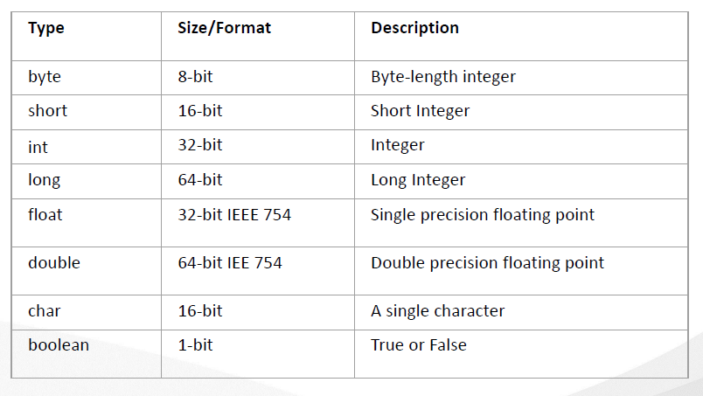
Data Types available in Java

Slide 4
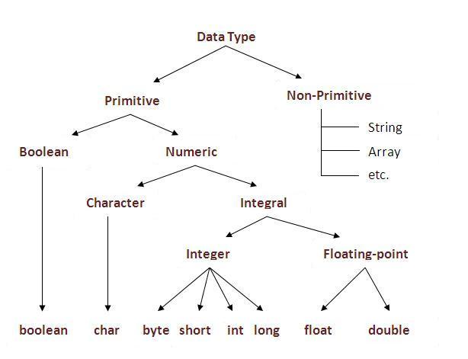
Data Types in Java
Data Type | Default Value | Default size
boolean | false | 1 bit
char | '\u0000' | 2 byte
byte | 0 | 1 byte
short | 0 | 2 byte
int | 0 | 4 byte
long | 0L | 8 byte
float | 0.0f | 4 byte
double | 0.0d | 8 byte

Slide 5
Variables in Java
Local Variables A variable which is declared inside the method is called local variable.
Instance Variables A variable which is declared inside the class but outside the method, is called instance variable . It is not declared as static.
Static variables A variable that is declared as static is called static variable. It cannot be local. We will have detailed learning of these variables in next session

Slide 6
Rules for variable declaration
Case-sensitive.
Any legal identifier — an unlimited-length sequence of Unicode letters and digits, beginning with a letter, the dollar sign "$", or the underscore character "_".
White space is not permitted.
Subsequent characters may be letters, digits, dollar signs, or underscore characters.
Name you choose must not be a keyword or reserved word.
If the name you choose consists of only one word, spell that word in all lowercase letters. If it consists of more than one word, capitalize the first letter of each subsequent word. Eg : gearRatio , currentGear
Constant value, such as static final int NUM_GEARS = 6, the convention changes slightly, capitalizing every letter and separating subsequent words with the underscore character.
Notes:
The convention, however, is to always begin your variable names with a letter, not "$" or "_". Additionally, the dollar sign character, by convention, is never used at all. You may find some situations where auto-generated names will contain the dollar sign, but your variable names should always avoid using it. A similar convention exists for the underscore character; while it's technically legal to begin your variable's name with "_", this practice is discouraged.
Conventions (and common sense) apply to this rule as well. When choosing a name for your variables, use full words instead of cryptic abbreviations. Doing so will make your code easier to read and understand. In many cases it will also make your code self-documenting; fields named cadence, speed, and gear, for example, are much more intuitive than abbreviated versions, such as s, c, and g.
By convention, the underscore character is never used elsewhere.

Slide 7
Identify variable & its data type
int a = 10;
char c = ‘A’;
float f = 23.56f; // 23,56F
double d = 23.4545d; //23.45D
long l = 23432l; // 232L
short s = 23234s; // 23423S
boolean b = true;
byte b = 123;

Slide 8
Sum of numbers
$sum
_
1num
n1*n2
prodofnos
store_result
❌ - as it contains spaces
✅
✅
❌ - as it starts with number
❌ - as it contains special symbol
✅
✅

Slide 9

Java Keywords
Don’t you dare use my special & beloved words!! ????

Slide 10
abstract | continue | For | New | Switch
assert | Default | Goto | Package | Synchronized
boolean | Do | If | Private | This
break | double | Implements | Protected | Throw
byte | Else | Import | Public | Throws
Case | Enum | Instanceof | Return | Transient
Catch | Extends | Int | Short | Try
Char | Final | Interface | Static | Void
Class | Finally | Long | Strictfp | Volatile
const | Float | native | super | while

Slide 11
String class in Java
String str = new String();
String str = new String(“This is Sample String”);
String str = “Hello”;

Slide 12
Operators - Unary
Negate ( - )
Increment – Pre and Post (++)
Decrement– Pre and Post (--)

Slide 13
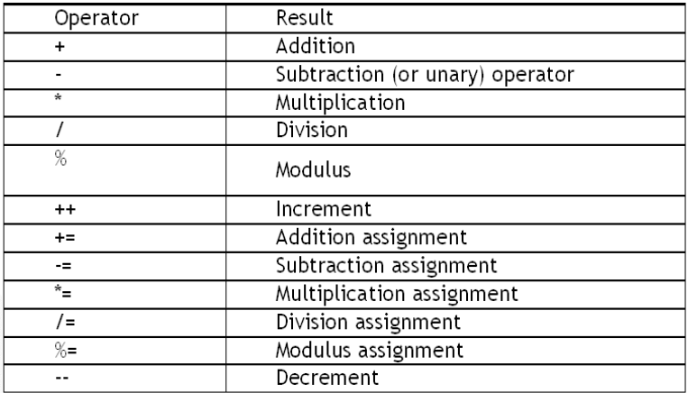
Operators & Assignments - Arithmetic

Slide 14
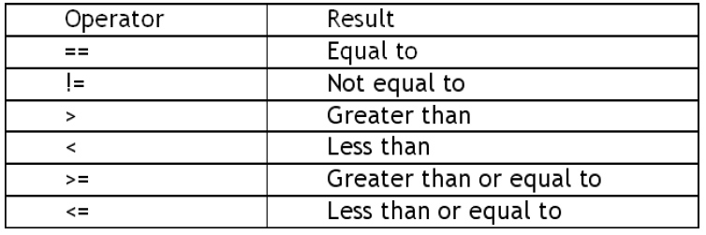
Operators & Assignments - Relational

Slide 15
Operators & Assignments - Logical
Logical AND (& , &&)
Logical OR (|, ||)
Logical NOT (!)
Operators & Assignments - Bitwise
Bitwise AND (&)
Bitwise OR (|)

Slide 16
Assignment on Operator :
if a = 4, b = 3; find the value of C = a++ * 6 + ++b*5 +10
Provide value for Ramesh basic salary. His dearness allowance is 40% of basic salary and house rent allowance is 70% of basic salary. Write a program to calculate his gross salary. EX: basic = 10,000, da = 4000, hra = 7000 gs = 21,1000
If a 3 digit no is provided, WAP to calculate the sum of its digits. Eg: no = 123. Then output should be 1 + 2+ 3 = 6

Slide 17
Life is full of decision making…
Control Flow Statements
Conditionally Execute statement
If
Else if
switch
Repeatedly use a block of statements
For loop
While loop
Do while loop

Slide 18
Using if condition…
if (<check condition here>)
{
// Perform action here
}
Using if else condition…
if (<check condition here>)
{
// Perform action here
}
else
{
// Perform some other action here
}

Slide 19
Rules
There can be if without an else
There cannot be an else without an if
Curly braces are optional if there is only 1 statement to execute

Slide 20
Replace multiple if… else code with switch
Switch(<Your Expression goes here>)
{
case value1: // Code statements goes here
break;
case value2: // Code statements goes here
break;
case value3: // Code statements goes here
break;
default: // Code statements goes here
break;
}

Slide 21
Assignment on Conditional Construct :1/2
int x,y=1; x = 10; if (x != 10 && x / 0 == 0) System.out.println(y); else System.out.println(++y);
Design for insurance system where insurance is provided based on following parameters .
If person is married he/she is insured
If person is unmarried and female with age 25 and above is insured.
If person is unmarried and male with age 30and above is insured.
WAP to take input gender, age and marital status as input. Find whether person is insured or not.
Any character is entered through the keyboard. WAP to find whether the character entered is a capital letter , small case letter, digit or a special symbol.[Hint : Use ASCII values to compare
Characters | Ascii values
A–Z | 65 – 90
a–z | 97 – 122
0–9 | 48 – 57
Special symbols | 0 – 47, 58 – 64, 91 – 96, 123 - 127

Slide 22
Assignment on Conditional Construct :1/2
Design for insurance system where insurance is provided based on following parameters .
If person is married he/she is insured
If person is unmarried and female with age 25 and above is insured.
If person is unmarried and male with age 30 and above is insured.
WAP to take input gender, age and marital status as input. Find whether person is insured or not.

Slide 23
Assignment on Conditional Construct: 2/2
Write a program for Travel Ticket Company to validate the ticket as follows: 123454/10 = 12345
123454%10 = 4
12345%7 Take input as 6 digit ticket number. Eg : 123454 Then remove the last digit in this case 4 remaining is 12345 This no 12345 if divided by 7 should give the remainder 4 (the last no that we removed). Then compare the remainder with the last digit of the 6 digit ticket no.
Display the result if no is valid or not
Try for no’s : 147103(should give valid) and 154123 should give invalid

Slide 24
Iteration Statements
For Loop
for (initialization; condition; iteration)
{
// Your code goes here }
while Loop
while(condition)
{
// Your code goes here }

Slide 25
Iteration Statements continued…
do while Loop
do
{
// Your code goes here }
while(condition)
Usage of break & continue statements

Slide 26
Assignment on Loops
Write a program to enter any number and calculate sum of its digits.
Write a program that displays the squares/cubes of the numbers from 0 to 14:
Write a program to enter any number and print all factors of the number.

Slide 27
Arrays
An array is a collection of similar data types. Array is a container object that hold values of homogenous type. It is also known as static data structure because size of an array must be specified at the time of its declaration.
An array can be either primitive or reference type. It gets memory in heap area. Index of array starts from zero to size-1.
Features of Array
It is always indexed. Index begins from 0.
It is a collection of similar data types.
It occupies a contiguous memory location.

Slide 28
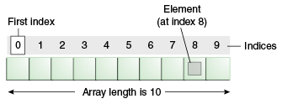
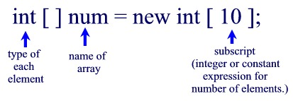
Arrays in Java
A group of liked types variables referred by a common name
Primitive Array Declaration

Slide 29
Array Declaration
Syntax :
datatype[ ] identifier;
or
datatype identifier[ ];
Both are valid syntax for array declaration. But the former is more readable.
Example :
int[ ] arr;
char arr[ ];
short[ ] arr;
long[ ] arr;
int[ ][ ] arr; // two dimensional array.

Slide 30
Initialization of an array
new operator is used to initialize an array.
Example :
int[ ] arr; //declaration
arr = new int[10]; // creation
int[ ] arr = new int[10]; //this creates an empty array named arr of integer type whose size is 10.
or
int[ ] arr = {10,20,30,40,50}; //this creates an array named arr whose elements are given.

Slide 31
Accessing array element
As mention earlier array index starts from 0. To access nth element of an array. Syntax
arrayname[n-1];
Example : To access 4th element of a given array
int[ ] arr = {10,20,30,40};
System.out.println("Element at 4th place" + arr[3]);
The above code will print the 4th element of array arr on console.
Note: To find the length of an array, we can use the following syntax: array_name.length. There are no braces infront of length. Its not length().

Slide 32
For - Each
For-each is another array traversing technique like for loop, while loop, do-while loop introduced in Java5.
It starts with the keyword for like a normal for-loop.
Instead of declaring and initializing a loop counter variable, you declare a variable that is the same type as the base type of the array, followed by a colon, which is then followed by the array name.
In the loop body, you can use the loop variable you created rather than using an indexed array element.
It’s commonly used to iterate over an array or a Collections class (eg, ArrayList)
do
Syntax: int num[] = {2,1,5,7,9}; for (type var : array) for(int var : num) { { statements using var; //print value of var } }
is equivalent to: for (int i=0; i<arr.length; i++) for (int i=0; i<num.length; i++) { { type var = arr[i]; //print value of num[i] statements using var; } }

Slide 33
Multi-Dimensional Array
A multi-dimensional array is very much similar to a single dimensional array. It can have multiple rows and multiple columns unlike single dimensional array, which can have only one full row or one full column.
Syntax:
datatype[ ][ ] identifier;
or
datatype identifier[ ][ ];
Initialization of Array
new operator is used to initialize an array.
Example:
int[ ][ ] arr = new int[10][10]; //10 by 10 is the size of array.
or
int[ ][ ] arr = {{1,2,3,4,5},{6,7,8,9,10},{11,12,13,14,15}};
// 3 by 5 is the size of the array.
Accessing array element
For both, row and column, the index begins from 0.
Syntax:
array_name[m-1][n-1]
Example:
int arr[ ][ ] = {{1,2,3,4,5},{6,7,8,9,10},{11,12,13,14,15}};
System.out.println("Element at (2,3) place" + arr[1][2]);

Slide 34
Assignment on Arrays :
Write a program to take 5 nos as input from the user and print the sum of all the numbers in the array
WAP to declare an array of 10 nos. Take input from the user. Print list of prime nos from the array.
Write a program to take names of 5 students and marks of 3 subjects for each student as input from the user. Display the average marks of all the student with their names. Print the name of the student with highest average. Output as follows : Name Average Riya 85 Suman 98 Rohit 97

Slide 35

Any Question ?

Slide 36

Thank you !

